Slide 1
Spatial Domain Processing
Intensity Transformations
Image enhancements
Probability
Histograms

Slide 2
Spatial Domain
Spatial Domain is the plane containing the pixels of an image.
Spatial domain techniques operate directly on the pixels of an image
As opposed to frequency domain in which operations are performed on the Fourier transform of an image, rather than on the image itself.
More efficient computationally and require less processing resources to implement.

Slide 3
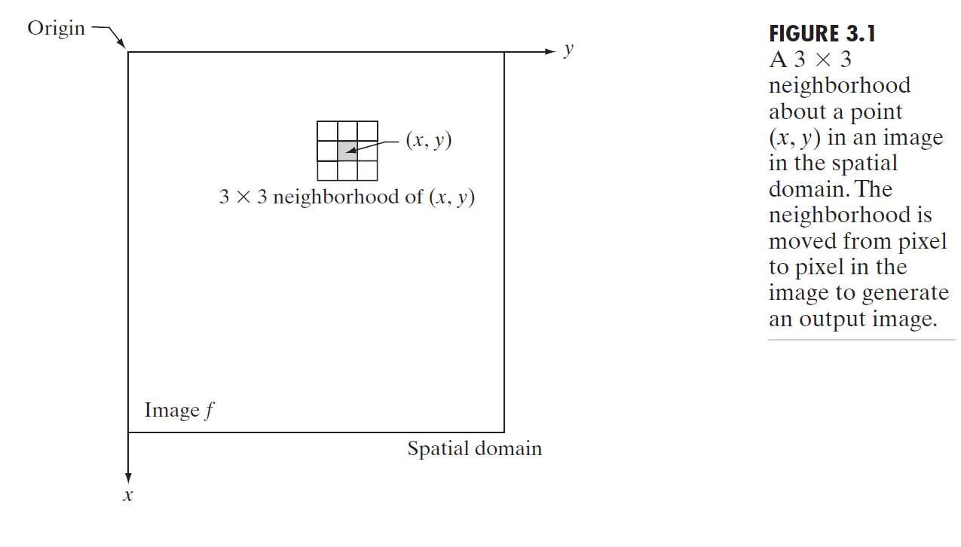
Spatial Domain

Slide 4
Spatial Filter
Also referred to as a spatial mask, kernel, template, or window
The type of operation performed in the neighborhood determines the nature of the filtering process.

Slide 5
Spatial Filtering
0 | 0 | 0 | 0 | 0 | 0 | 0 | 0 | 0 | 0
0 | 0 | 0 | 10 | 10 | 10 | 0 | 0 | 0 | 0
0 | 0 | 10 | 20 | 20 | 20 | 10 | 40 | 0 | 0
0 | 10 | 20 | 30 | 0 | 20 | 10 | 0 | 0 | 0
0 | 10 | 0 | 30 | 40 | 30 | 20 | 10 | 0 | 0
0 | 10 | 20 | 30 | 40 | 30 | 20 | 10 | 0 | 0
0 | 10 | 20 | 10 | 40 | 30 | 20 | 10 | 0 | 0
0 | 10 | 20 | 30 | 30 | 20 | 10 | 0 | 0 | 0
0 | 0 | 10 | 20 | 20 | 0 | 10 | 0 | 20 | 0
0 | 0 | 0 | 10 | 10 | 10 | 0 | 0 | 0 | 0

Slide 6
Spatial Filtering
0 | 0 | 0 | 0 | 0 | 0 | 0 | 0 | 0 | 0
0 | 0 | 0 | 10 | 10 | 10 | 0 | 0 | 0 | 0
0 | 0 | 10 | 20 | 20 | 20 | 10 | 40 | 0 | 0
0 | 10 | 20 | 30 | 0 | 20 | 10 | 0 | 0 | 0
0 | 10 | 0 | 30 | 40 | 30 | 20 | 10 | 0 | 0
0 | 10 | 20 | 30 | 40 | 30 | 20 | 10 | 0 | 0
0 | 10 | 20 | 10 | 40 | 30 | 20 | 10 | 0 | 0
0 | 10 | 20 | 30 | 30 | 20 | 10 | 0 | 0 | 0
0 | 0 | 10 | 20 | 20 | 0 | 10 | 0 | 20 | 0
0 | 0 | 0 | 10 | 10 | 10 | 0 | 0 | 0 | 0

Slide 7
Spatial Filtering
0 | 0 | 0 | 0 | 0 | 0 | 0 | 0 | 0 | 0
0 | 0 | 0 | 10 | 10 | 10 | 0 | 0 | 0 | 0
0 | 0 | 10 | 20 | 20 | 20 | 10 | 40 | 0 | 0
0 | 10 | 20 | 30 | 0 | 20 | 10 | 0 | 0 | 0
0 | 10 | 0 | 30 | 40 | 30 | 20 | 10 | 0 | 0
0 | 10 | 20 | 30 | 40 | 30 | 20 | 10 | 0 | 0
0 | 10 | 20 | 10 | 40 | 30 | 20 | 10 | 0 | 0
0 | 10 | 20 | 30 | 30 | 20 | 10 | 0 | 0 | 0
0 | 0 | 10 | 20 | 20 | 0 | 10 | 0 | 20 | 0
0 | 0 | 0 | 10 | 10 | 10 | 0 | 0 | 0 | 0

Slide 8
Spatial Filtering
0 | 0 | 0 | 0 | 0 | 0 | 0 | 0 | 0 | 0
0 | 0 | 0 | 10 | 10 | 10 | 0 | 0 | 0 | 0
0 | 0 | 10 | 20 | 20 | 20 | 10 | 40 | 0 | 0
0 | 10 | 20 | 30 | 0 | 20 | 10 | 0 | 0 | 0
0 | 10 | 0 | 30 | 40 | 30 | 20 | 10 | 0 | 0
0 | 10 | 20 | 30 | 40 | 30 | 20 | 10 | 0 | 0
0 | 10 | 20 | 10 | 40 | 30 | 20 | 10 | 0 | 0
0 | 10 | 20 | 30 | 30 | 20 | 10 | 0 | 0 | 0
0 | 0 | 10 | 20 | 20 | 0 | 10 | 0 | 20 | 0
0 | 0 | 0 | 10 | 10 | 10 | 0 | 0 | 0 | 0

Slide 9
Filtering-- Will see later

Slide 10
Intensity Transformation
Linear Transformation
Piecewise Linear Transformation

Slide 11
Image Enhancement
Enhancement is the process of manipulating an image so that the result is more suitable than the original for a specific application.

Slide 12
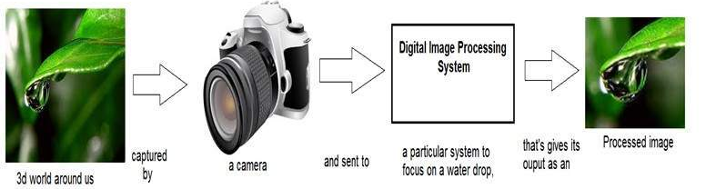
Image transformations
Transformation is a function. It maps one set to another set after performing some operations.
Digital Image Processing system performs the transformation.

Slide 13
Image transformation
Consider the equation
g(x,y)=T(f(x,y))
f(x,y) – input image, transformation is applied to this image.
g(x,y) – output image (processed image).
T is a transformation function.

Slide 14
Intensity Transformation
The smallest possible neighborhood is of size 1 x 1.
In this case, g depends only on the value of f at a single point (x, y) and T in Eq. (3.1-1) becomes an intensity (also called gray-level or mapping) transformation function of the form
S=T(r)

Slide 15
Image transformation
The transformation can be also represented as
s=T(r)
r – pixel value of the input image f(x,y)
s – pixel value of the output image g(x,y)

Slide 16
Probability
Probability Distribution

Slide 17
Introduction to probability
PMF and CDF are both related to probability. They will be used in Histogram Equalization.
PMF – Probability Mass Function.
It gives the probability of each number in the data set (frequency of each element).

Slide 18
Probability distribution
In a probability distribution, each probability is between 0 and 1, inclusive. Because all possible values of the random variable are included in the probability distribution, the sum of the probabilities is 1.

Slide 19
Probability – PMF
Calculating PMF from image matrix
PMF
Image matrix
1 2 7 5 6
7 2 3 4 5
0 1 5 7 3
1 2 5 6 7
6 1 0 3 4
0 | 2 | 2/25
1 | 4 | 4/25
2 | 3 | 3/25
3 | 3 | 3/25
4 | 2 | 2/25
5 | 4 | 4/25
6 | 3 | 3/25
7 | 4 | 4/25

Slide 20
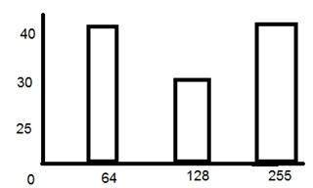
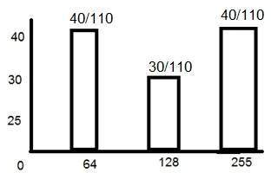
Probability – PMF
Calculating PMF from histogram
Frequency of gray level values for an 8 bits per pixel image.
Not monotonically increasing function

Slide 21
Probability – CDF
CDF – Cumulative Distributed Function
Cumulative sum of values calculated by PMF

Slide 22
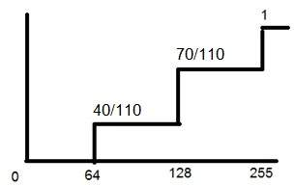
Probability – CDF
CDF will be calculated using the histogram
CDF makes the PDF grow monotonically
Monotonical growth is necessary for histogram equalization.

Slide 23
Histogram
Tonal Adjustment
Image Thresholding
Image Enhancement
Segmentation

Slide 24
What is a Histogram?

Slide 25
Histograms:
An image histogram is a graphical representation of pixel intensities count.
Possible intensity values are represented along the x-axis and their count is represented along the y-axis.

Slide 26
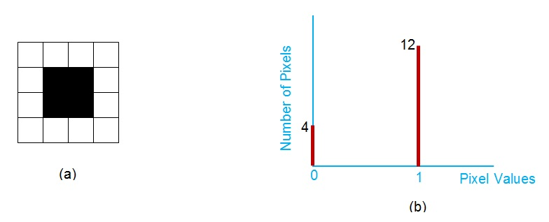
Histograms:
Histogram of Binary Image
Image Courtesy: https://www.allaboutcircuits.com/technical-articles/image-histogram-characteristics-machine-learning-image-processing/

Slide 27
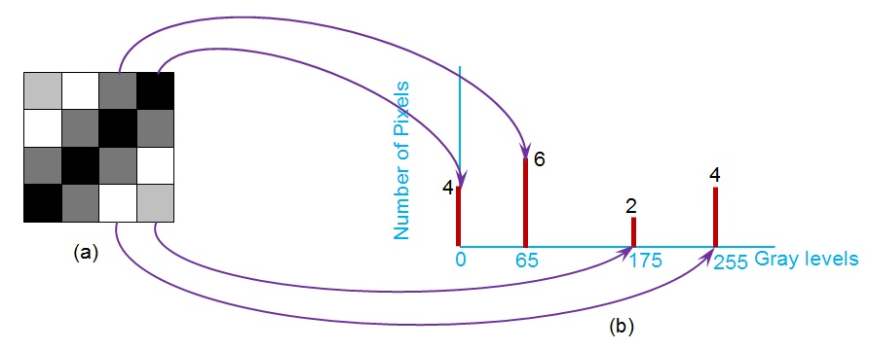
Histograms:
Histogram of Gray Scale Image
Image Courtesy: https://www.allaboutcircuits.com/technical-articles/image-histogram-characteristics-machine-learning-image-processing/

Slide 28
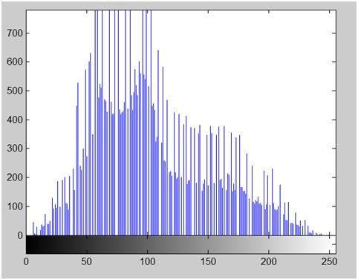
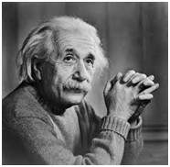
Image histogram
x axis – shows the range of pixel values.
For 8 bpp image, we have 256 levels of gray shades

Slide 29
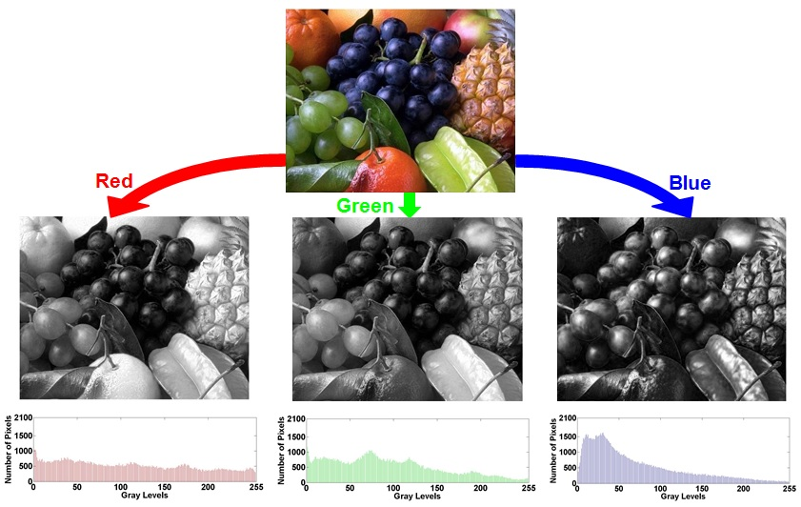
Histograms:
Histogram of Color Image
Image Courtesy: https://www.allaboutcircuits.com/technical-articles/image-histogram-characteristics-machine-learning-image-processing/

Slide 31
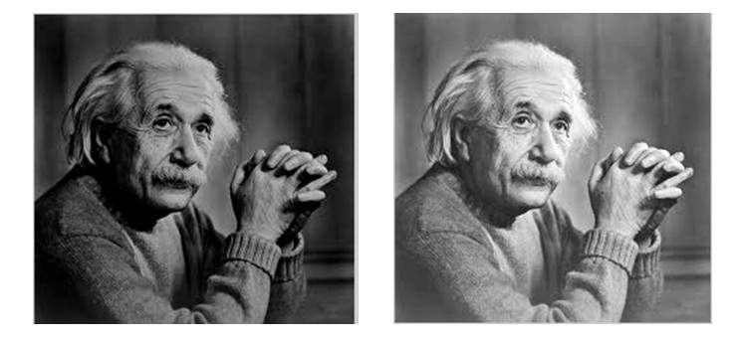
Brightness
Brightness is a relative term. It can be defined as the amount of energy output by a source of light relative to the source we are comparing to.
Image on the right is brighter than image on the left.

Slide 32


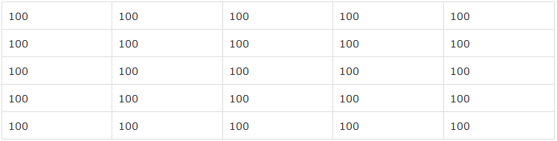

Brightness
Brightness can be easily increased or decreased by simple addition or subtraction to the image matrix

Slide 33
Contrast
The contrast of the image can be defined as the difference between maximum pixel intensity and minimum pixel intensity.
Max. int. = 0, Min. int. =0
Contrast = 0–0=0
Max. int. = 100, Min. int. =100
Contrast = 100–100=0

Slide 34
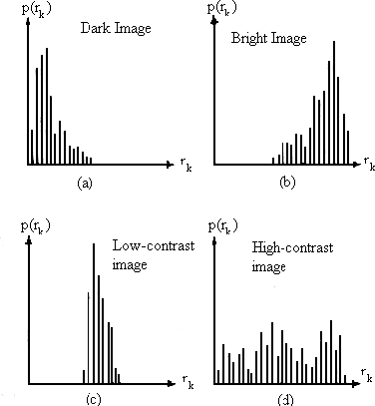
Generic figures of histograms
The appearance of histogram reveals a lot of information about the contrast of the image and the mean gray level.
An image of low contrast has
a histogram that is concentrated around a small range of
intensities.
Images of high contrast are more interesting and pleasant for the human eye.

Slide 35
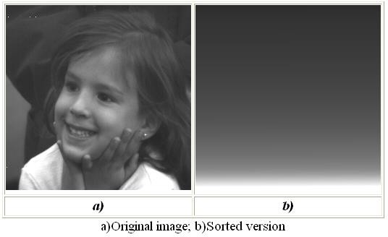
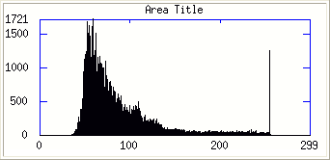
Two different images with the same histogram
The appearance of histogram reveals a lot of information about
the contrast of the image and the mean gray level BUT :
It doesn’t give any information regarding the location or the type of objects present
in the image. This information
is important because it is related to the image content.
Two images can have identical histograms and still be completely different in terms of content.

Slide 36

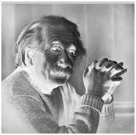
Negative transformation
Original
Negative
s = (L – 1) – r

Slide 37
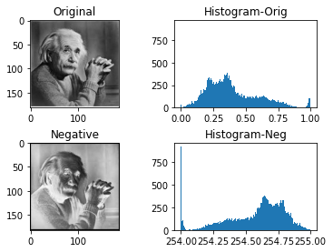

Slide 38
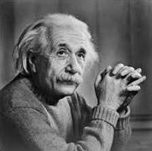
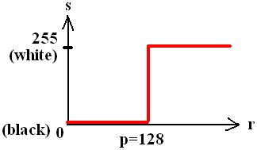
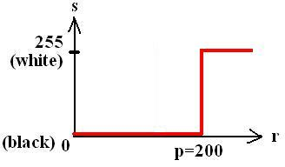
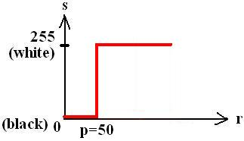
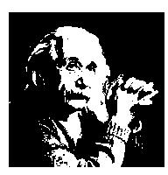
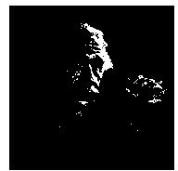
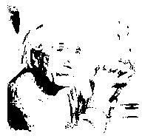
Image Transformation- Thresholding
Original
image

Slide 39
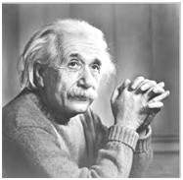
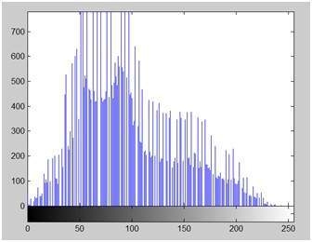
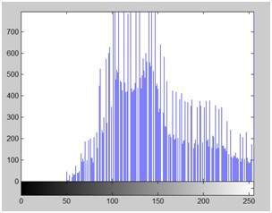
Histogram sliding
Brightness is changed by shifting the histogram to left or right.
+50

Slide 40
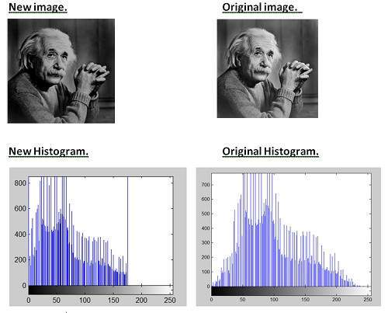
Histogram sliding
- 30

Slide 41
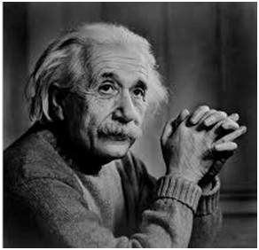
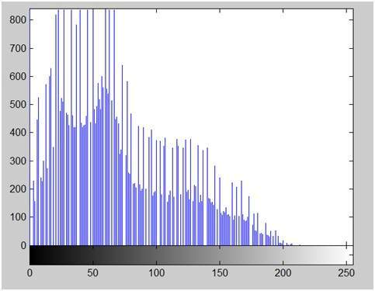
Histogram stretching
Contrast can be increased using:
1. Histogram stretching
2. Histogram equalization
Contrast is the difference between maximum and minimum pixel intensity. Contrast = 225.

Slide 42


Increasing the contrast
f(x,y)
g(x,y)
Low contrast image
High contrast image

Slide 43

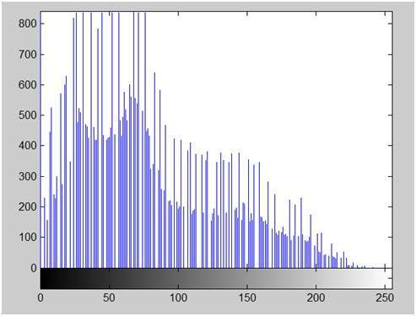
Contrast stretching
Before
Contrast = 225
After
Contrast = 240

Slide 44

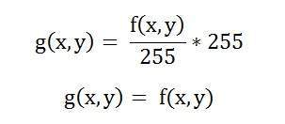
Contrast stretching
This formula doesn’t work always. If there is 1 pixel with intensity 255:
Contrast stretching has
no effect!!!

Slide 45
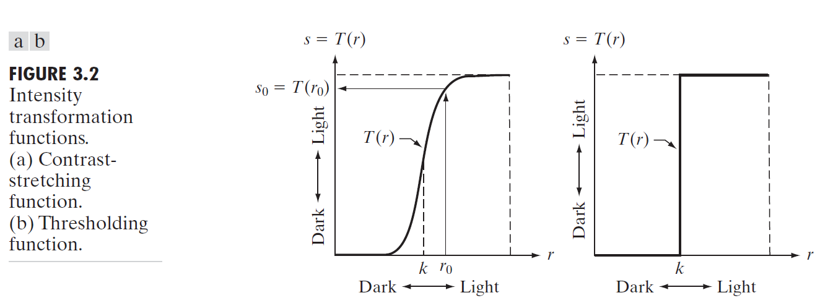
Contrast Stretching and Thresholding

Slide 46
Applications of Histograms:
Image Enhancement
Image Thresholding

Slide 47
Improve the image contrast [Histogram Equalization]
Enhance the image by spreading the most frequent Intensity values.
CV2.EQUALIZEHIST(IMG)
Steps:
Calculate the frequency against each intensity value
Compute the probability of each frequency
Compute Cumulative Distribution Function (CDF)
Multiple the CDF with the required intensity levels
Round the resultant value to Floor

Slide 48
Histogram Equalization
3 | 2 | 4 | 5
7 | 7 | 8 | 2
3 | 1 | 2 | 3
5 | 4 | 6 | 7
Suppose this matrix is representing pixel intensities.

Slide 49
Histogram Equalization
3 | 2 | 4 | 5
7 | 7 | 8 | 2
3 | 1 | 2 | 3
5 | 4 | 6 | 7
Intensity if Pixels range between 1 – 8
Suppose we want to apply histogram equalization
And scale the intensity to 1 - 20

Slide 50
Histogram Equalization
Step 1
3 | 2 | 4 | 5
7 | 7 | 8 | 2
3 | 1 | 2 | 3
5 | 4 | 6 | 7
Count the total number of pixels belonging to each
Intensity.

Slide 51
Histogram Equalization
Step 1
3 | 2 | 4 | 5
7 | 7 | 8 | 2
3 | 1 | 2 | 3
5 | 4 | 6 | 7
Pixel Intensities | 1 | 2 | 3 | 4 | 5 | 6 | 7 | 8
No. of Pixels | 1 | 3 | 3 | 2 | 2 | 1 | 3 | 1

Slide 52
Histogram Equalization
Step 2
3 | 2 | 4 | 5
7 | 7 | 8 | 2
3 | 1 | 2 | 3
5 | 4 | 6 | 7
Find the probability of each pixel intensity.

Slide 53
Histogram Equalization
Step 2
3 | 2 | 4 | 5
7 | 7 | 8 | 2
3 | 1 | 2 | 3
5 | 4 | 6 | 7
Find the probability of each pixel intensity.
Total number of elements are 16.
Probability = No. of pixels associated to a particular intensity
Total number of elements (i.e. 16)

Slide 54
Histogram Equalization
Step 2
3 | 2 | 4 | 5
7 | 7 | 8 | 2
3 | 1 | 2 | 3
5 | 4 | 6 | 7
Pixel Intensities | 1 | 2 | 3 | 4 | 5 | 6 | 7 | 8
No. of Pixels | 1 | 3 | 3 | 2 | 2 | 1 | 3 | 1
Probability | .0625 | .1875 | .1875 | .125 | .125 | .0625 | .1875 | .0625

Slide 55
Histogram Equalization
Step 3
3 | 2 | 4 | 5
7 | 7 | 8 | 2
3 | 1 | 2 | 3
5 | 4 | 6 | 7
Next step is to compute the cumulative probability

Slide 56
Histogram Equalization
Step 3
Pixel Intensities | 1 | 2 | 3 | 4 | 5 | 6 | 7 | 8
No. of Pixels | 1 | 3 | 3 | 2 | 2 | 1 | 3 | 1
Probability | .0625 | .1875 | .1875 | .125 | .125 | .0625 | .1875 | .0625
Cumulative Probability | .0625 | .25 | .4375 | .5625 | .6875 | .75 | .9375 | 1

Slide 57
Cumulative probability
Loosely speaking, p(r_{k}) is an estimate of the probability of occurrence of intensity level in an image. The sum of all components of a normalized histogram is equal to 1.

Slide 58
Histogram Equalization
Step 4
3 | 2 | 4 | 5
7 | 7 | 8 | 2
3 | 1 | 2 | 3
5 | 4 | 6 | 7
As we want to increase the intensity to the reange1 -20,
Multiply each Cumulative Probability by 20

Slide 59
Histogram Equalization
Step 4
Pixel Intensities | 1 | 2 | 3 | 4 | 5 | 6 | 7 | 8
No. of Pixels | 1 | 3 | 3 | 2 | 2 | 1 | 3 | 1
Probability | .0625 | .1875 | .1875 | .125 | .125 | .0625 | .1875 | .0625
Cumulative Probability(C.P) | .0625 | .25 | .4375 | .5625 | .6875 | .75 | .9375 | 1
C.P x 20 | 1.25 | 5 | 8.75 | 11.25 | 13.75 | 15 | 18.75 | 20

Slide 60
Histogram Equalization
Step 5
3 | 2 | 4 | 5
7 | 7 | 8 | 2
3 | 1 | 2 | 3
5 | 4 | 6 | 7
Last step in to round the decimal values (floor rounding)

Slide 61
Histogram Equalization
Step 5
Pixel Intensities | 1 | 2 | 3 | 4 | 5 | 6 | 7 | 8
No. of Pixels | 1 | 3 | 3 | 2 | 2 | 1 | 3 | 1
Probability | .0625 | .1875 | .1875 | .125 | .125 | .0625 | .1875 | .0625
Cumulative Probability | .0625 | .25 | .4375 | .5625 | .6875 | .75 | .9375 | 1
C.P x 20 | 1.25 | 5 | 8.75 | 11.25 | 13.75 | 15 | 18.75 | 20
Floor Rounding | 1 | 5 | 8 | 11 | 13 | 15 | 18 | 20
Notes:
Probability=

Slide 62
Histogram Equalization
Final Result
3 | 2 | 4 | 5
7 | 7 | 8 | 2
3 | 1 | 2 | 3
5 | 4 | 6 | 7
8 | 5 | 11 | 13
18 | 18 | 20 | 5
8 | 1 | 5 | 8
13 | 11 | 15 | 18
Original Image has been transformed to equalized image with different intensities

Slide 63
Histogram Equalization
In OpenCV you can use: CV2.equalizeHist(IMG)

Slide 64
Histogram Equalization
import cv2 as cv
im1=cv.imread('original.png',0)
equ_img= cv.equalizeHist(im1)
cv.imshow('Binary Image', equ_img)
cv.waitKey(0)
cv.destroyAllWindows()

Slide 65
Practise:
Write a python program to implement histogram equalization approach discussed here.
Solve :
A 3-bit image of size 4×5 is shown below. Compute the histogram equalized image.
0 | 1 | 1 | 3 | 4
7 | 2 | 5 | 5 | 7
6 | 3 | 2 | 1 | 1
1 | 4 | 4 | 2 | 1

Slide 67
Contrast Stretching

Slide 68
Histogram Equalization

Slide 69
Histogram Specification

Slide 70
Each method has its advantages and disadvantages.

Slide 72
Observations
Discussion

Slide 73
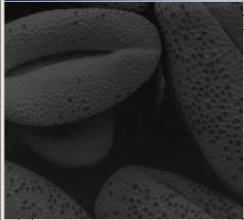
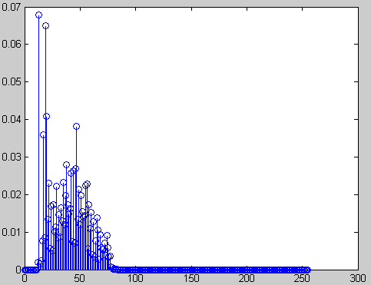
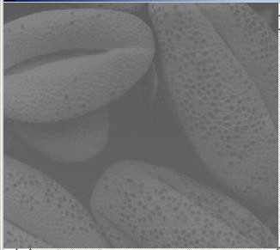
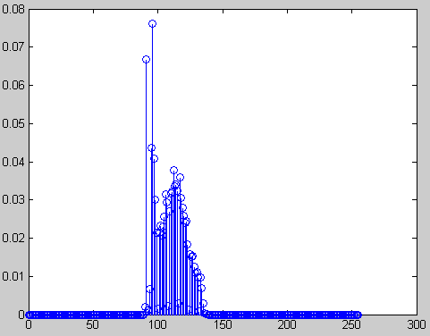
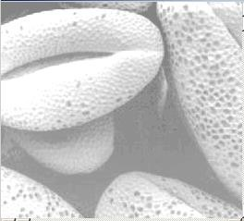
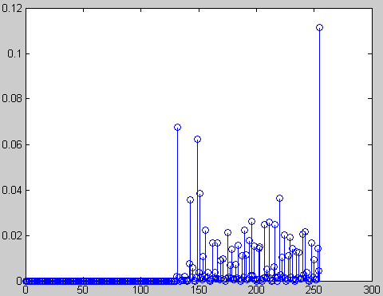
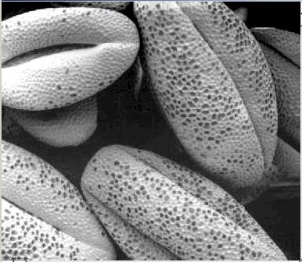
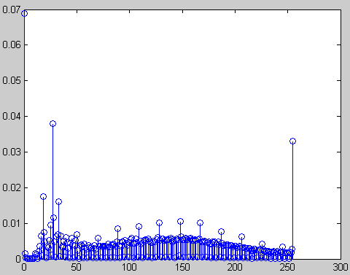
A set of images with same content but different histograms
dark image
low contrast image
1
3
bright image
4
high contrast image
2

Slide 74
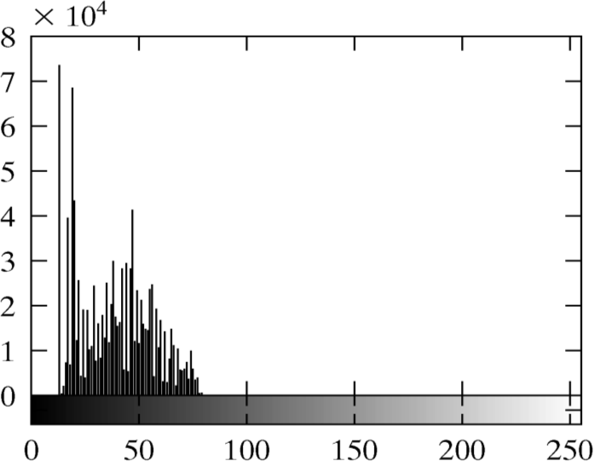

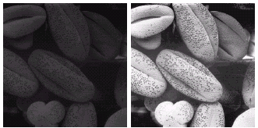
Histogram equalization applied to the dark image
1

Slide 75
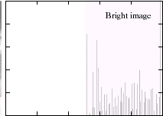

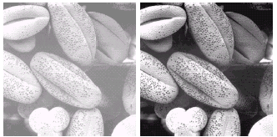
Histogram equalization applied to the bright image
2

Slide 76
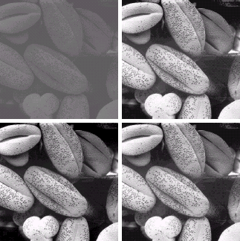


Histogram equalization applied to the low and high contrast images
3
4

Slide 77
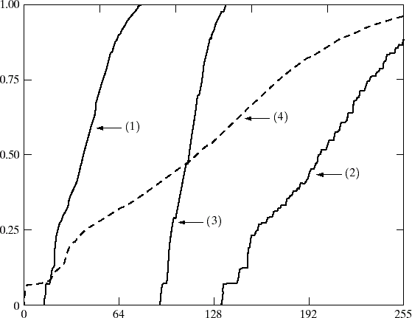
Transformation functions for histogram equalization for the previous example
The function 𝑇(𝑟) used to equalize the four images of the previous example is shown below.
Observe that the transformation function in cases 1,2,3 maps a small range of intensities to the entire range of intensities.
Observe that for an image which is already bright, the transformation is an almost
diagonal line.

Slide 78
Histogram Specification
We are looking for a technique which can provide an image with any pre-
specified histogram.
This is called histogram specification.
We assume that the original image has pdf 𝑝_{𝑟}(𝑟).
We are looking for a transformation 𝑧 = 𝑇(𝑟) which provides an image
with a specific pdf 𝑝_{𝑧}(𝑧) .
Histogram specification uses histogram equalization as an intermediate step.

Slide 79
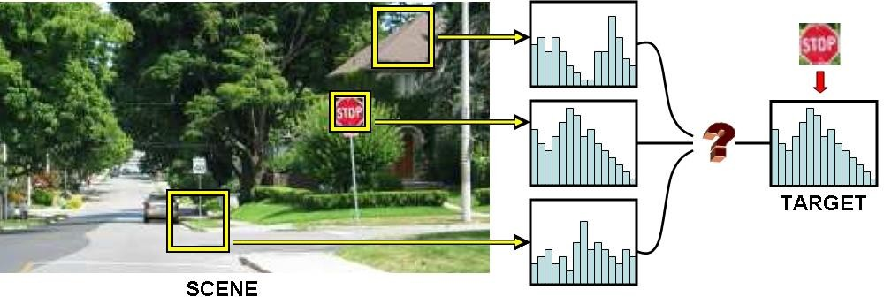
Local Histogram Equalization
In many cases histograms are needed for local areas of an image.
Possible applications could be:
Pattern detection based on histogram.
Adaptive enhancement.
Adaptive thresholding.
Object tracking based on histogram.

Slide 80
Local Histogram Equalization for local image enhancement
The histogram processing methods discussed previously are global
(transformation is based on the intensity distribution of the entire image).
This global approach is suitable for overall enhancement.
There are cases in which it is necessary to enhance details over small areas in an image.
The number of pixels in these areas may have negligible influence on the computation of a global transformation.
The solution is to devise transformation functions based on the intensity distribution in a neighbourhood around every pixel.
The above approach facilitates tasks such as detection, tracking and
spatially adaptive thresholding.

Slide 81
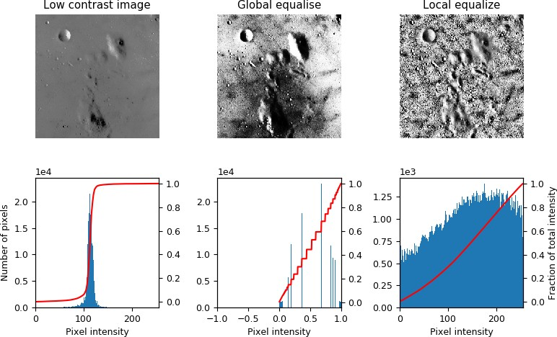
Example: Local Histogram Equalization

Slide 82

Example: Local Histogram Equalization
Observe the details revealed with local (spatially adaptive) histogram
equalization.

Slide 83
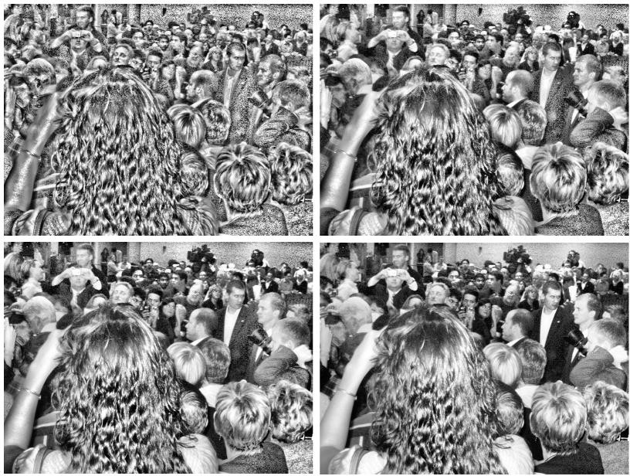
Example: Local Histogram Equalization
Top left: A window size of [25 25]. Top right: A window size of [64 64].
Bottom left: A window size of [100 100]. Bottom right: A window size of [200 200].

Slide 84

Example: Local Histogram Equalization
Top left: A window size of [15 15]. Top right: A window size of [30 30].
Bottom left: A window size of [75 75]. Bottom right: A window size of [150 150].

Slide 85



Example: Local Histogram Equalization

Slide 86


Local Histogram Equalization Drawbacks
Image is split into smaller regions and the traditional histogram equalization is applied to each region.
The smaller equalized images are combined into one to obtain a final resultant image.
The final image appears to be very blocky in nature and has different contrast levels for each individual region.
Post-processing is required to remove the blocking artifacts.

Slide 87
Read
Chapter 3 Gonzalez, Rafael C. Digital image processing. Pearson education India, 2009.

Slide 88
Solution– practice is given on slide # 67
The new image is as follow: Here intensities are calculate within the same ranges as give. i.e. 0-7
0 | 2 | 2 | 4 | 5
7 | 4 | 6 | 6 | 7
6 | 4 | 4 | 2 | 2
2 | 5 | 5 | 4 | 2

